Slide 1




THE SAFE SYSTEM APPROACH
WHY? HOW? WHAT?

Slide 2
IT’S TIME TO REENVISION ROADWAY SAFETY
Notes:
JASON
Approximately 1 in 6 fatalities on KY’s roadways are Non-motorized users.
Fatalities over the ten-year period from 2016 to 2025 is more than the population of 11 KY counties. Safety isn't about numbers at all - safety is about people.

Slide 3

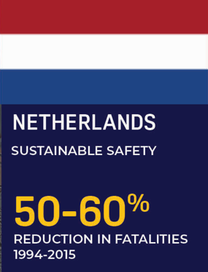



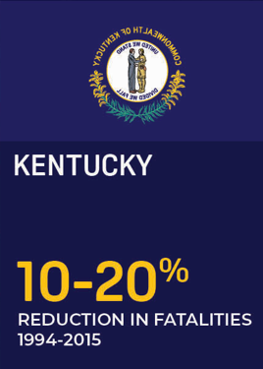
OTHER COUNTRIES ARE SEEING SIGNIFICANT DECREASES IN ROADWAY FATALITIES. WHY NOT KY?
Notes:
JASON
The Safe System approach is not a new concept. It has existed for more than 30 years in countries across the globe. Each of the early adopters of the Safe System approach, shown on this slide, has seen marked decreases in traffic fatalities across their roadway systems—each with at least a 50% reduction in fatalities.

Slide 4
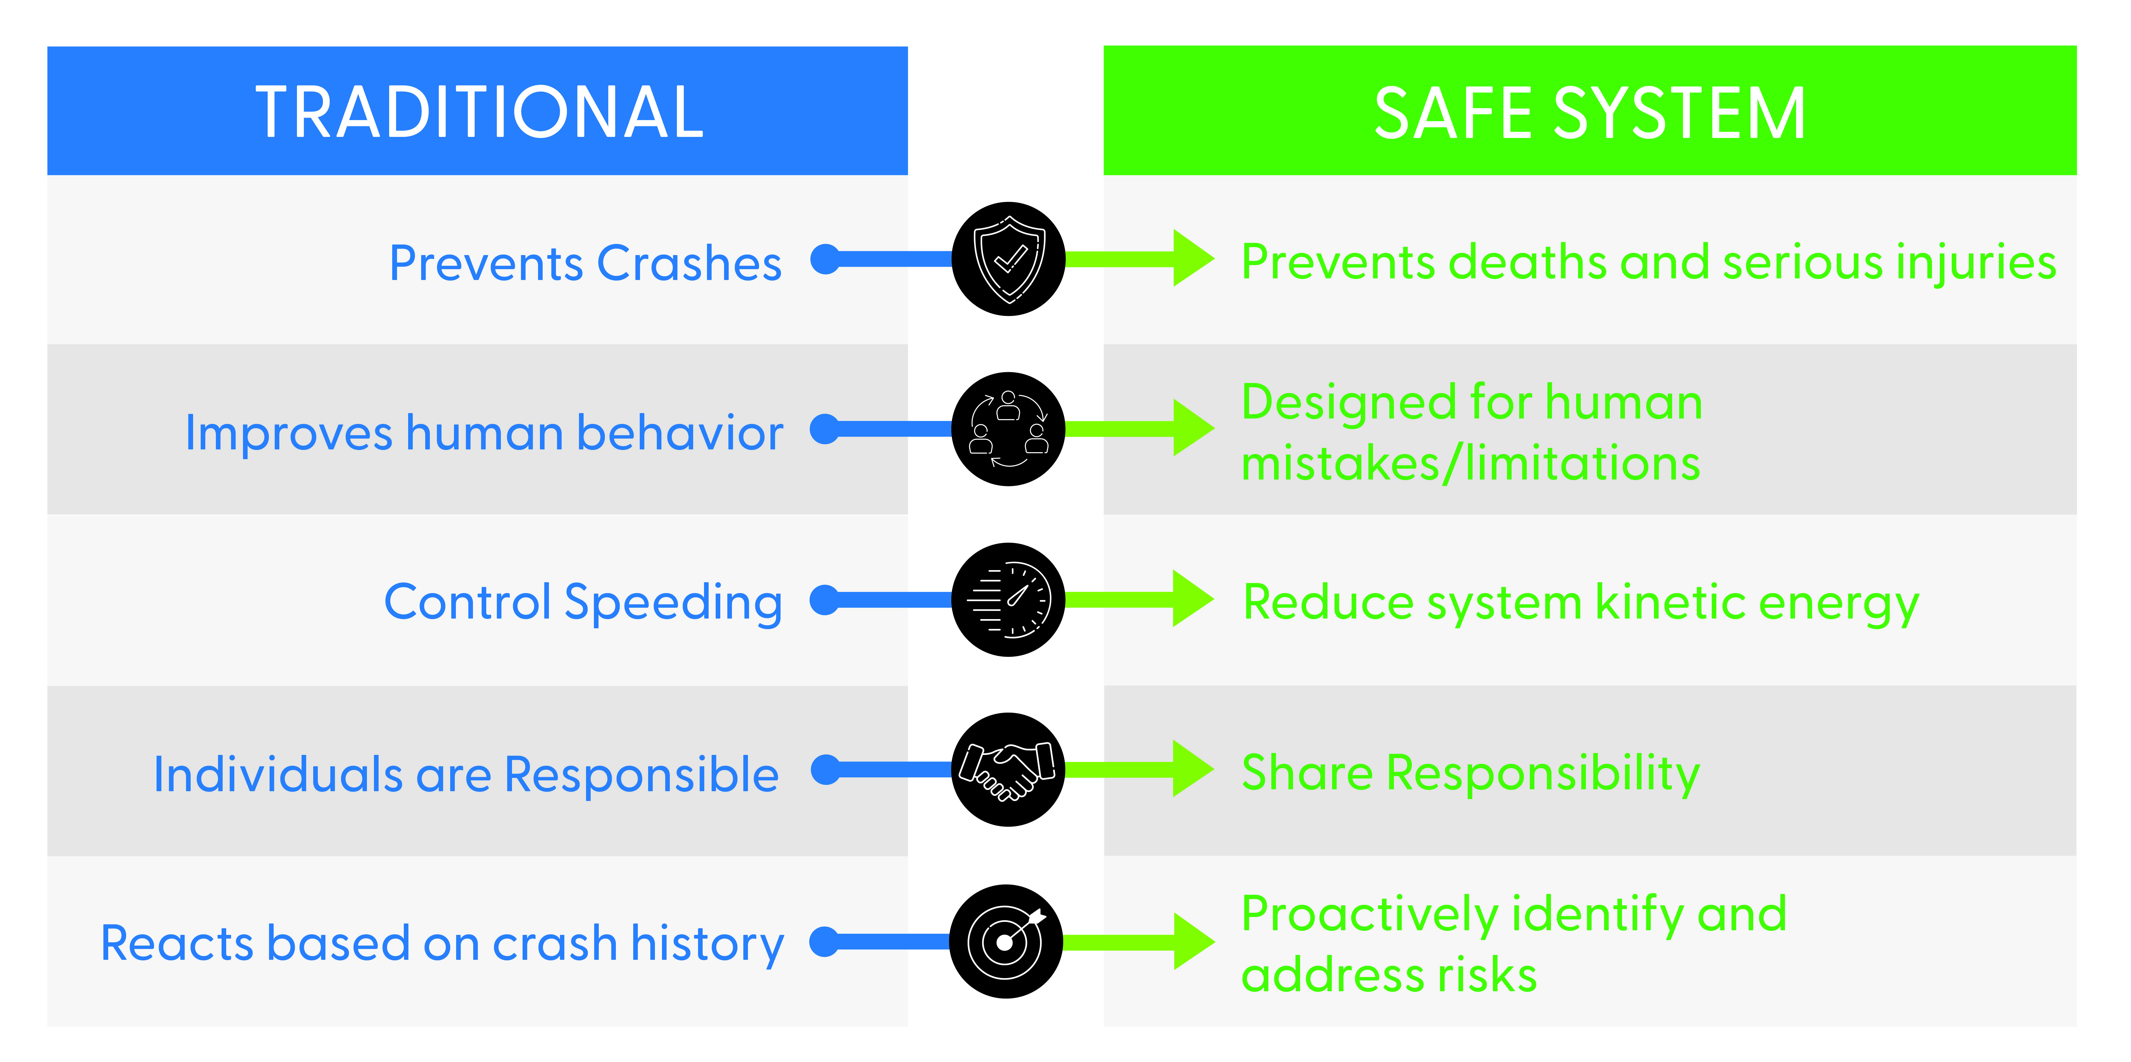
Notes:
JASON
All crashes > Fatality and Injury crashes. PDOs are an inconvenience, but not the focus.
Kinetic energy - Speeds and angle of collisions. VRUs.
Crash rate factors. > Highway Safety Manual and CMFs allowed for a more proactive approach. Look at predicted crashes and excess expected crashes.

Slide 5

WHAT IS THE SAFE SYSTEM APPROACH?
Notes:
MIKE
6 key principles (outside of circle) – Death and Serious Injuries are Unacceptable, Humans Make Mistakes, Humans are Vulnerable, Responsibility is Shared, Safety is Proactive and Redundancy is Crucial.
6 elements (inside of circle) – KY added “Partnership”.
The goal is to prevent death and minimize serious injury through system design. The Safe SystemsApproach – when implemented fully and strategically – is proven to work.

Slide 6

WHERE CAN KYTC HAVE THE MOST IMPACT?
Notes:
MIKE
While it’s important to work with outside organizations to address all the elements, the people in this room have a lot of influence on two of these elements – Safer Roads and Safer Speeds

Slide 7
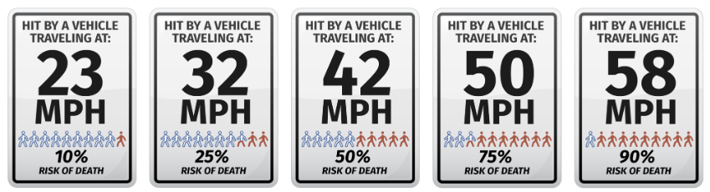
Importance of travel speed
Increases in travel speed exponentially increase kinetic energy.
Notes:
MIKE

Slide 8
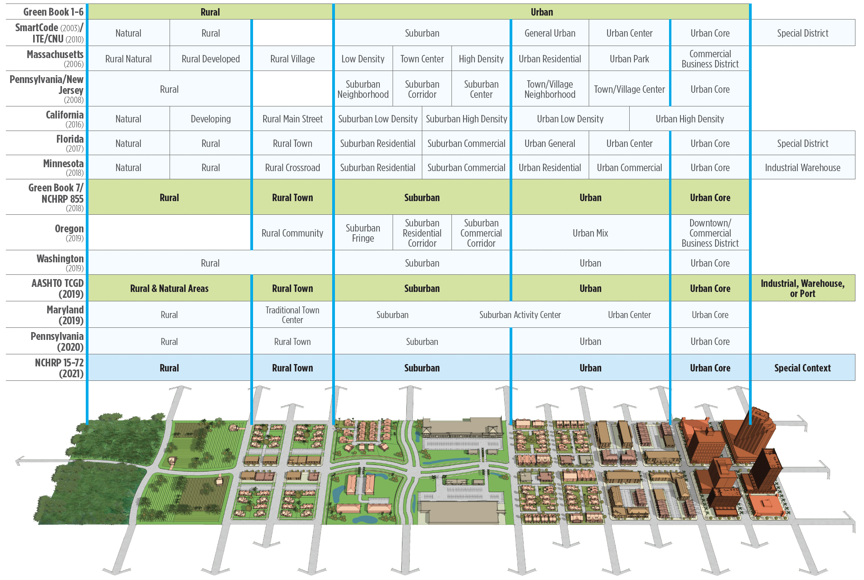
Context matters
Source: Exhibit 2-20 NCHRP 320 Aligning Geometric Design with Roadway Context
Notes:
MIKE

Slide 9
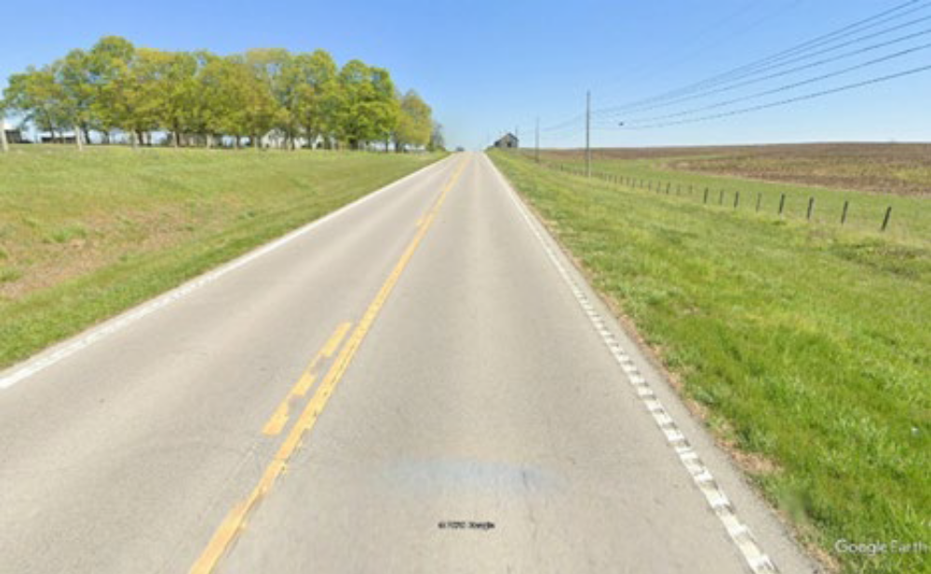
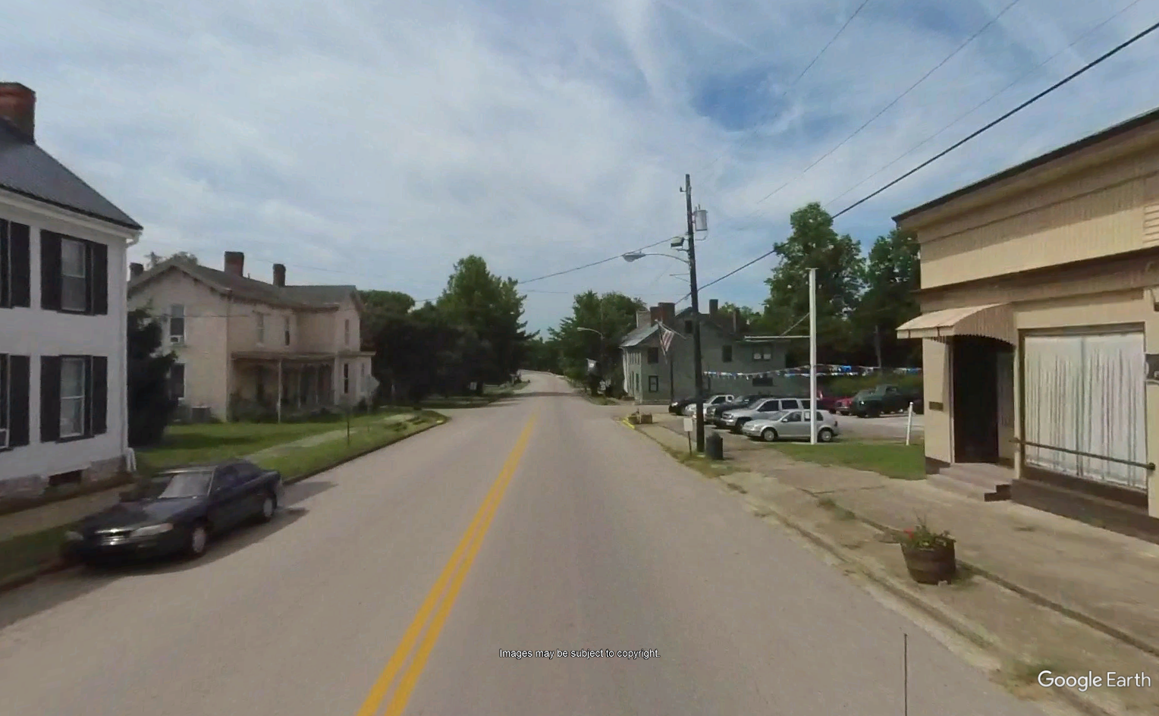
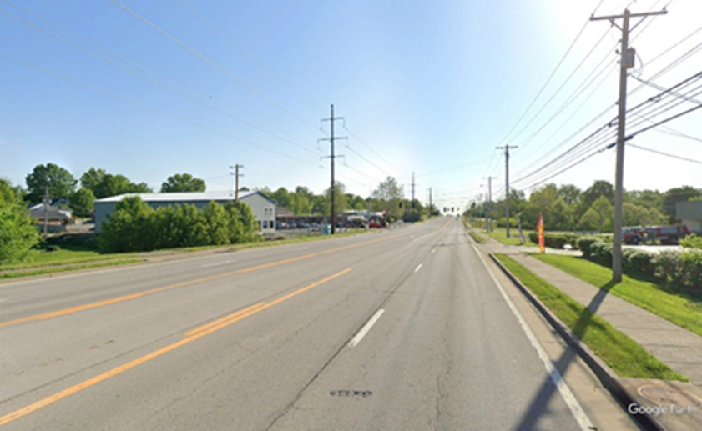
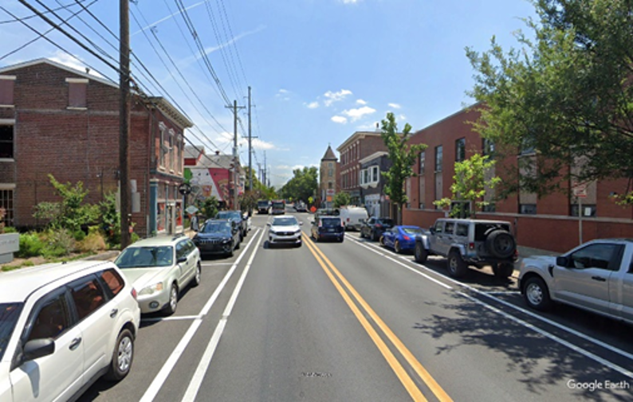
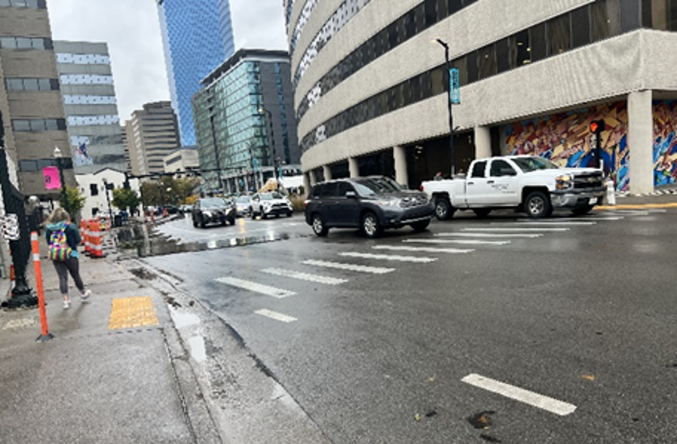
Context matters
Rural
Rural Town
Suburban
Urban
Urban Core
Notes:
MIKE
Rural - Areas with the lowest densities, few houses or structures. Common land uses include agriculture, natural resource preservation, and outdoor recreation.
Rural Town - Areas with low density but diverse land uses with commercial main street character, potential for on-street parking and sidewalks and small setbacks.
Suburban - Areas with medium density, mixed land uses within and among structures (including mixed-use town centers, commercial corridors, and residential areas), and varied setbacks. Sidewalks are often present. Most parking is off street.
Urban - Areas with high density, mixed land uses and prominent destinations, potential for some on-street parking and sidewalks, and mixed setbacks.
Urban Core - Areas with the highest densities, mixed land uses within and among predominately high-rise structures, and small setbacks. Sidewalks are abundant.

Slide 10
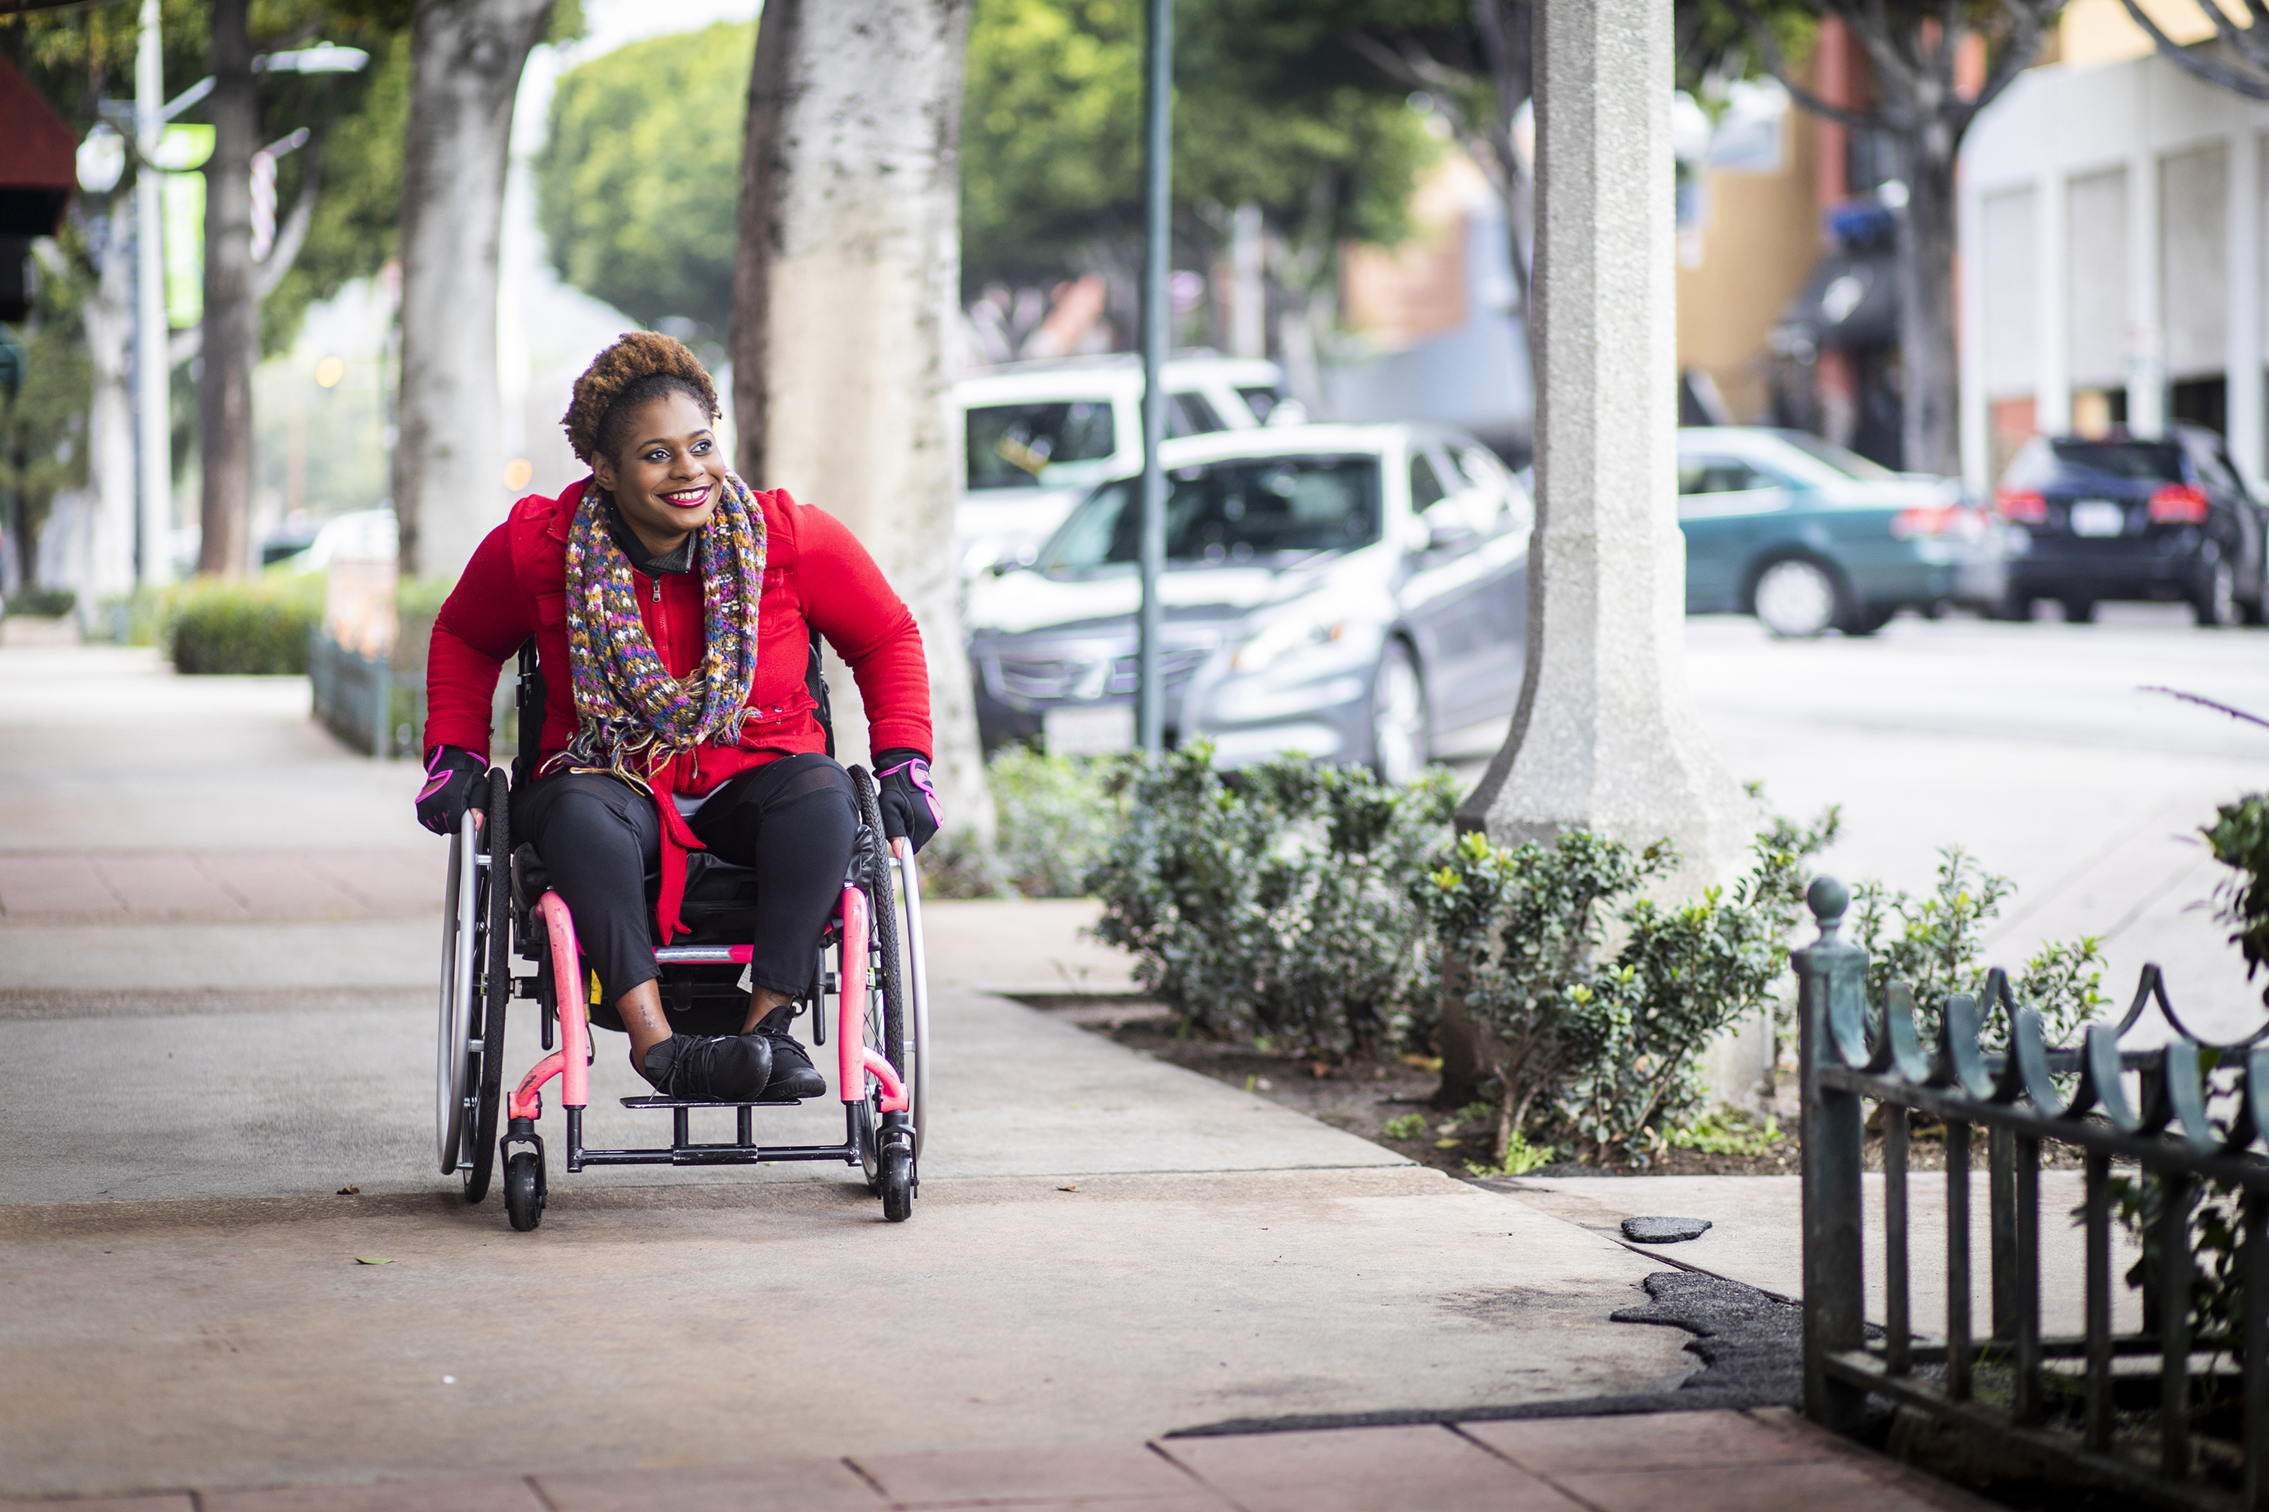
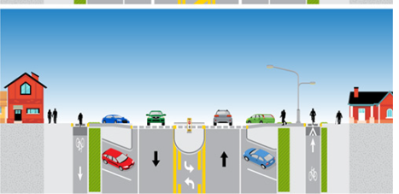
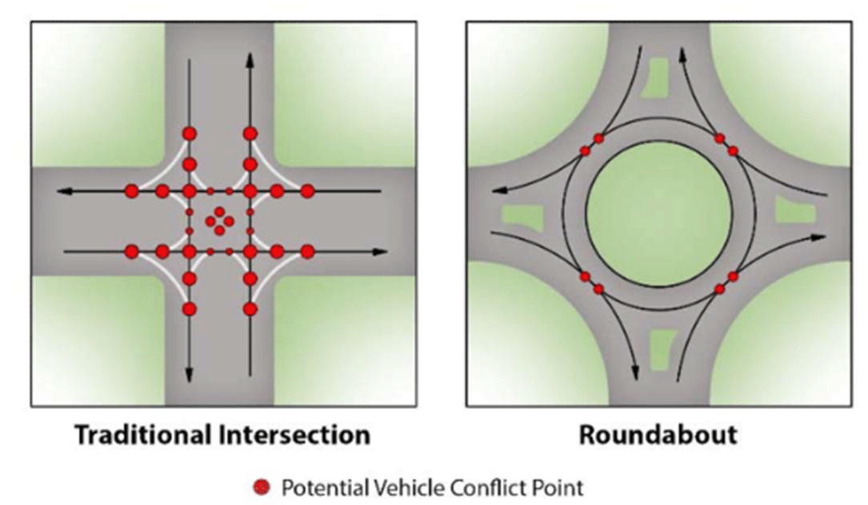
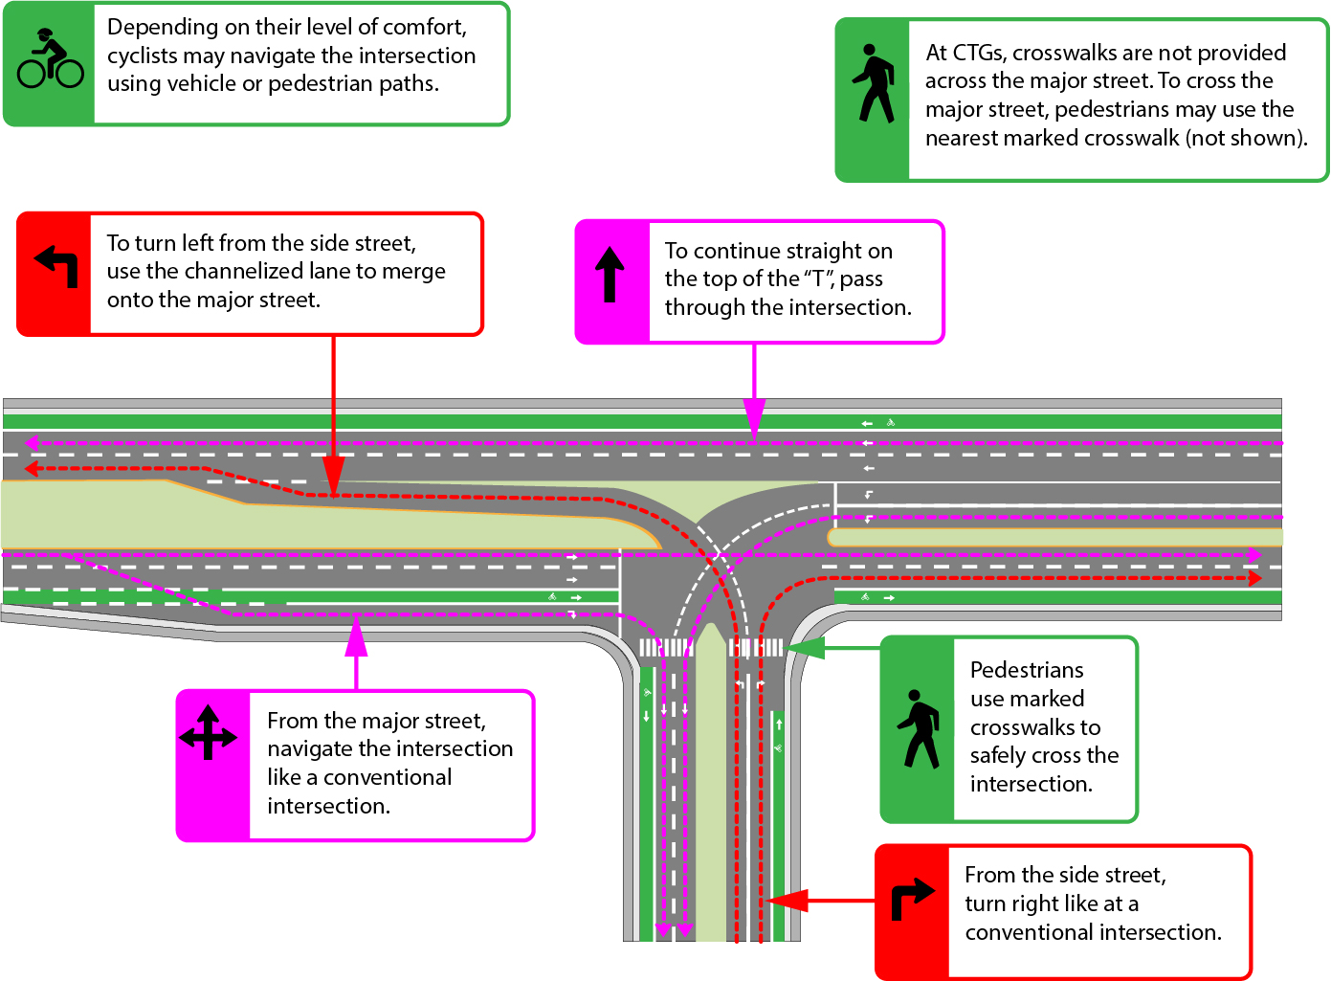
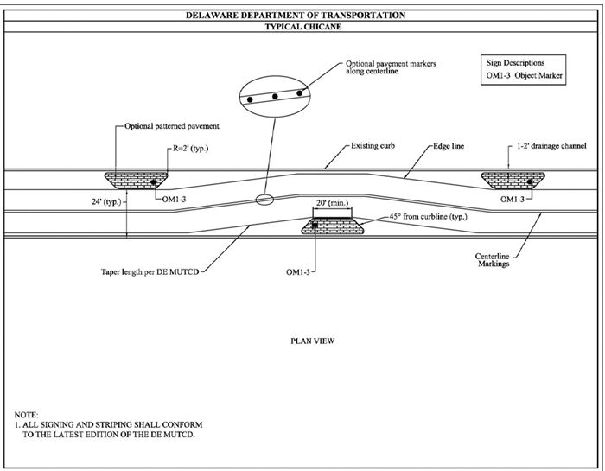
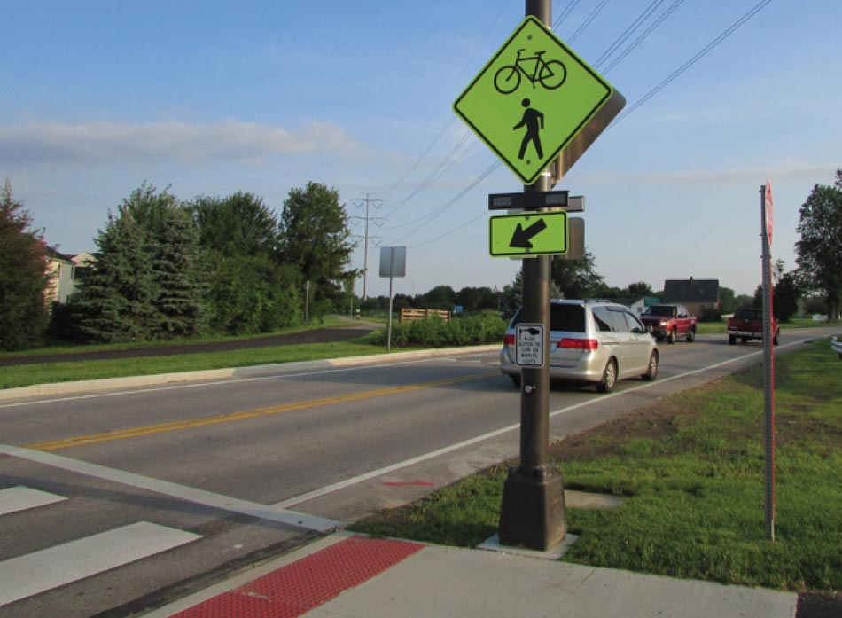
Implementing a safe system
Separate Users
Reallocate Roadway Cross Section
Minimize Conflict Points
Innovative Intersection Design
Increase Attentiveness/ Awareness
Design for Target Speeds
Notes:
MIKE

Slide 11


Implementation of the SAFE SYSTEM APPROACH in Kentucky
Notes:
JASON
This SPR project began in 2023 and has been extended for three additional years to continue implementation. Two additional projects were added to develop training and tools in the Project Development and the Project Delivery and Preservation areas.

Slide 12
Implementing a safe system approach
Review of SSA Successes
Core Team Input and Prioritization
Implementation Teams Develop Selected Strategies
Executive Level Review
Notes:
JASON
Initial project scope of implementation in project development was broadened to include project delivery. It a very broad approach. Also, although project development projects are probably the most effective way to implement SSA since changes can be designed and constructed, only a small part of our network is touched by project development projects. If we looked at feasible ways to apply the SSA as part of the maintenance process, we could have much greater impacts.
A Core Group of diverse subject matter experts from the Department of Highways (project development and delivery) participated in multiple SSA workshops to evaluate these strategies, engage in brainstorming sessions, and provide input on potential implementation approaches. In total, more than 80 strategies were reviewed, including tools applicable at the project level, as well as broader, programmatic strategies that would require further development prior to implementation.
With careful consideration of the Core Group’s priorities, KYTC Leadership selected 28 strategies to advance to the implementation phase.

Slide 13
Implementation areas
Statewide
Planning
Design & Geometrics
HSIP
Traffic Operations
TSMO
Permits
Construction
Operations & Maintenance
Notes:
JASON
The diverse subject-matter expertise of the core team brought valuable insights during the development of strategies. However, we also recognized that successful implementation typically depends on the guidance, responsibilities, and processes of specific functional areas. To support this, Implementation Areas were identified to guide the further development and application of the strategies. Some of these implementation areas were combined to form six Implementation Teams.

Slide 14
Process Change & Improvement - An idea whose implementation will require Cabinet leadership to change current practices or policies. A change in law may be required for some ideas.
Training & Education - Providing training and resources to staff and the public.
Best Practice - A practice that should be regularly implemented by all transportation professions.
Tool in the Toolbox - Strategies that may not be used on every project, but project-specific conditions indicate its use may reduce serious and fatal injury collisions.
IMPROVEMENT TYPES
Notes:
JASON
The strategies were grouped into four categories based on Improvement Type.
The first category, Tools in the Toolbox, has been developed into a resource containing countermeasures that can be applied at the project level.
The remaining three categories include strategies that are currently being further refined and advanced by our Implementation Teams.

Slide 15

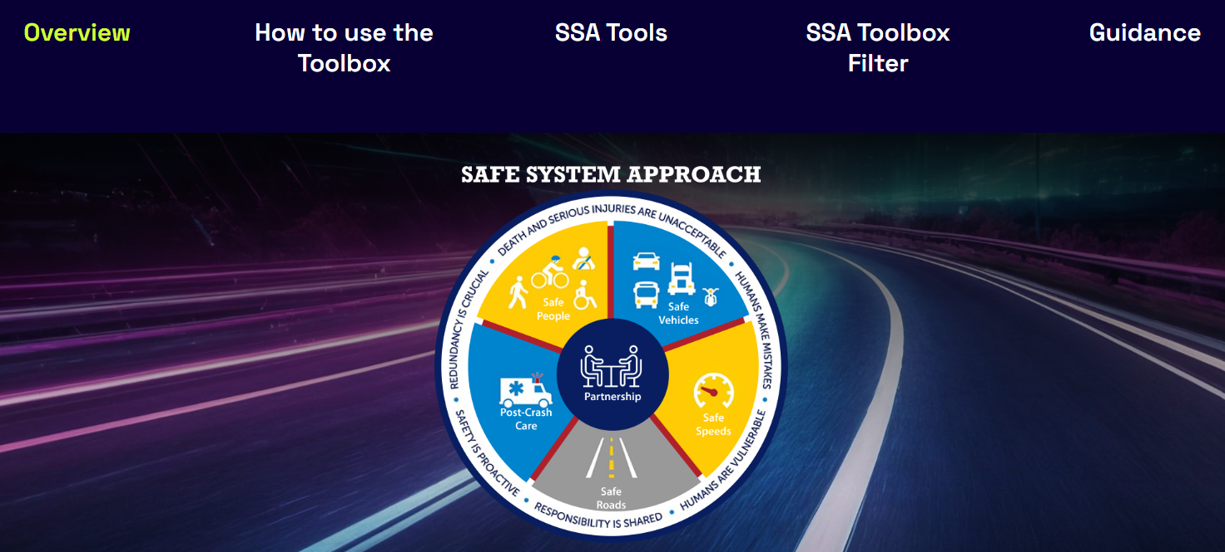
SSA toolbox
Notes:
MIKE
KYTC’s SSA Toolbox provides project-specific safety countermeasures that can be applied, where appropriate, to reduce fatal and serious injury crashes. The Toolbox includes KYTC-specific application guidance and implementation considerations for each tool. In addition, standard details have been developed for several tools to facilitate their incorporation into project proposals and construction plan sets. The toolbox is housed on the Safe Mobility website and can be accessed using the QR code above. Soon, you will also be able to access the toolbox through the Highway Knowledge Portal.

Slide 16
ssa tools
Address Visual Traps with Pavement Markings
Back-in Angle Parking
Buffered Bike Lanes
Cable Median Barrier
Centerline Buffers
Centerline Turn Hardening
Colored Pavement
Convert Low-Volume Intersections from
Two-Way Stop to All-Way Stop Control
Curb Extensions
Curve Widening
Enhanced Signing
Evaluate and Implement Road Reconfigurations
Flashing Yellow Right Turns
Friction Surface Treatments
High Visibility Crosswalks
Increase Use of Roadside Barriers and End Terminals
Intersection Buffers
Lateral Shifts and Chicanes
Leading Pedestrian Interval (LPI)
Lighting
Median and Pedestrian Refuge Island
Median Barriers on Undivided Roadways
Positive Offset Turn Lanes
Protected Intersections
Raised Intersections
Rectangular Rapid Flashing Beacon
Rest in Red
Roadway Narrowing - Pavement Markings
Sequential Dynamic Chevron Warning System
Slope Flattening
Speed Feedback and Changeable Message Signs
Speed Reduction Markings
Successively Smaller Curves
Supplemental In-Lane Pavement Markings
Superelevation Improvement
Speed Hump
Speed Tables and Raised Crosswalks
Transverse Pavement Rumbles
Two-Way Left Turn Lane (TWLTL) Restrictions
Use Traffic Signal Timing to meet Target Speed
Notes:
MIKE
The Toolbox currently contains 40 safety tools. Of course, this isn’t all inclusive. There are certainly other countermeasures that can be applied to your projects that are not on the list. Sometimes coordination will need to occur with a KYTC program, or division, or public involvement may be needed. If so, this was usually noted on the tool’s webpage.

Slide 17
SSA Toolbox
Filter Groups
Roadway Contexts
Rural
Rural Town
Focus Area
Speed Management
Project Type
New or Reconstruction
Safety Category
Suburban
Urban
Urban Core
Intersections
Pedestrian/ Bicycle
Roadway Departure
Construction on Existing Roadway
Resurfacing
Remove Severe Conflicts
Reduce Vehicle Speeds
Manage Conflicts in Time
Increase Awareness
Notes:
MIKE
The toolbox is filterable by 4 categories:
Context (rural, rural town, urban, suburban, urban core)
Focus area (roadway departure, intersection, speed management, bike/pedestrian)
Project type (new/reconstruction, project on existing alignment, resurfacing project)
Safety category (1-removes severe conflicts, 2-reduces vehicle speeds, 3-manages conflicts in time, 4-increases attentiveness – Based on FHWA’s Design Hierarchy Safety Tiers

Slide 18
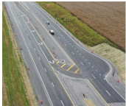
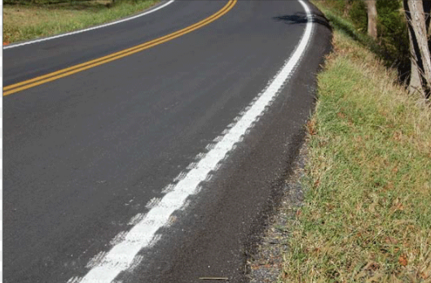
Two-pronged approach:
project development and the resurfacing program
Highway Plan projects touch a very small percentage of the total roadway network each year and never touch significant portions of the network.
The Resurfacing Program eventually touches almost every portion of the network including all roadway classifications.
SSA Training is under development for both approaches.
Notes:
MIKE
The resurfacing program is viewed as the best opportunity to implement the SSA on a wide basis to reduce fatal and injury crashes on KY’s roadways. Pilot training has been delivered and will soon be rolled out statewide. SSA tools can be implemented at the same time as resurfacing projects to take advantage of:
The “clean slate” a new surface provides (especially for pavement marking changes)
The efficiency of contracting multiple types of work in one project (when it makes sense)
The cyclical nature of resurfacing that will provide the opportunity for a systematic approach to reducing fatal and injury crashes across the roadway network..
While implementing SSA through project development may not touch as much of the roadway network as the resurfacing program, it will provide more opportunity to “build in safety” as new and improved roadways are being envisioned, designed, and constructed.
A project is underway to develop SSA Training for Project Development. That topic will be discussed in a general session on Friday morning.

Slide 19
Safe System Approach
Tools and Strategies

Slide 20

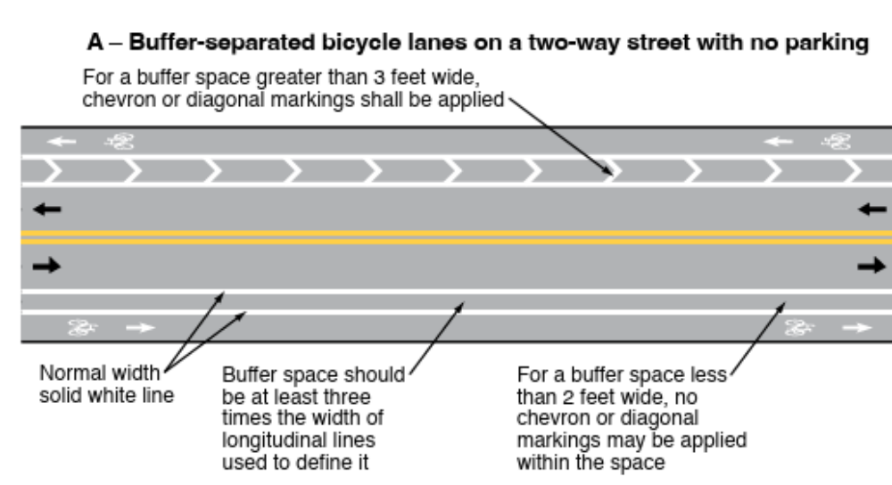
Buffered Bike Lanes
Image Source: MUTCD, 11th Edition, Figure 9E-6
Notes:
JASON
Buffered bike lanes establish a marked buffer between cyclists and vehicle traffic, which can mitigate interactions, conflicts, and crashes between bicyclists and vehicles while creating a network of safer roadways for bicycling. A buffered bike lane is created by separating the bicycle lane from the adjacent general-purpose lane with longitudinal pavement markings that may include chevron or diagonal line markings. If the separation includes a vertical element such as a raised median or pavement-mounted flexible tubular markers or delineators , it becomes a separated bicycle lane. Consistent with the Safe System Approach principle of recognizing human vulnerability, buffered bicycle lanes separate users in space and can enhance safety for all road users.

Slide 21

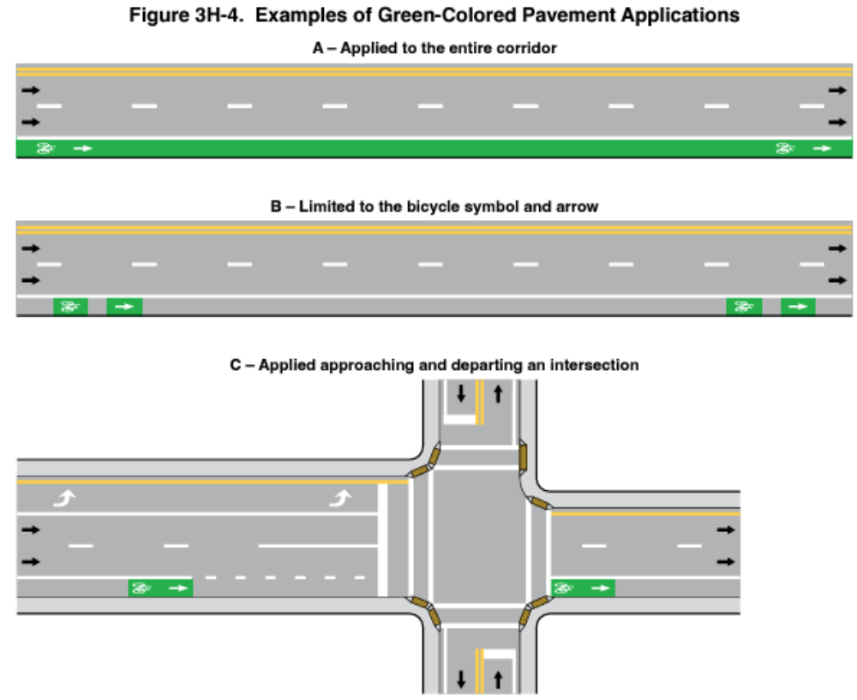
Colored Pavement
Notes:
JASON
When bicycle lanes lack separation from vehicle lanes, green pavement may draw attention to their presence.

Slide 22

High Visibility Crosswalks
Image Source: Google Earth. Bardstown Rd., Louisville
Notes:
JASON
High-visibility crosswalks have pavement markings (i.e., bar pair, longitudinal bar, ladder) that are visible to drivers and pedestrians from a longer distance than crosswalks with traditional transverse lines. They can also help users make safer decisions about where to cross.

Slide 23
Median and Pedestrian Refuge Islands
Image Source: Google Earth, Beaumont Centre Circle, Lexington, KY
Image Source: Google Earth, Alumni Drive, Lexington, KY
Notes:
Jason
A median is the area between opposing lanes of traffic, excluding turn lanes. Medians in urban and suburban areas can be created using pavement markings, raised medians, or islands to separate motorized and non-motorized road users. A pedestrian refuge island (or crossing area) is a median with a refuge area that is intended to help protect pedestrians who are crossing a road. Pedestrian refuge islands allow pedestrians to cross one direction of travel at a time and provide a space in which to wait if vehicles are coming in the other direction.

Slide 24

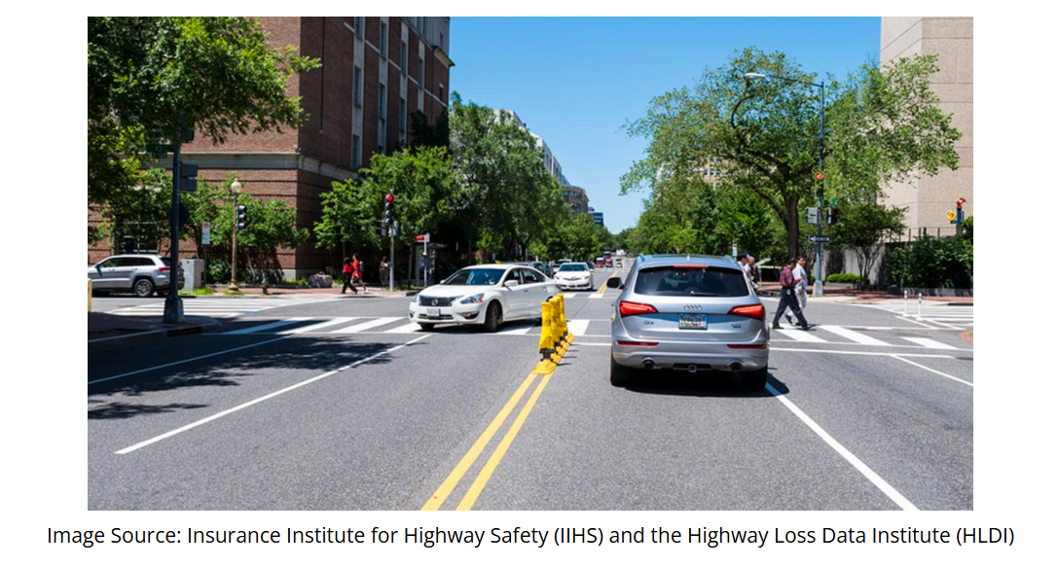
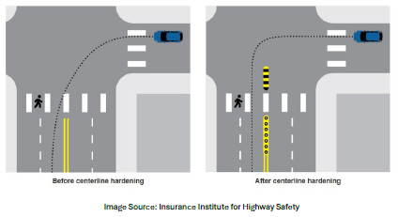
Centerline Turn Hardening
Notes:
MIKE
Centerline turn hardening entails installing features such as bollards and curbs to prevent drivers from cutting across intersections at a diagonal. They can improve pedestrian safety and address failure-to-yield crashes caused by left-turning vehicles by encouraging drivers to make left turns at slower speeds.

Slide 25
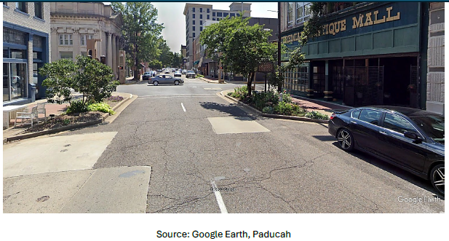
Curb Extensions
Notes:
MIKE
A curb extension is a horizontal extension of the sidewalk into the street that results in a narrower roadway section. They may be placed at intersection corners or mid-block. A curb extension at an intersection is called a corner extension or bulb-out. A curb extension located mid-block is called a choker.
Curb extensions increase pedestrian visibility, shorten crossing distance for pedestrians, and encourage pedestrians to cross at designated locations. They also tighten intersection curb radii, encourage slower turning speeds, and prevent vehicles from illegally parking at corners.

Slide 26

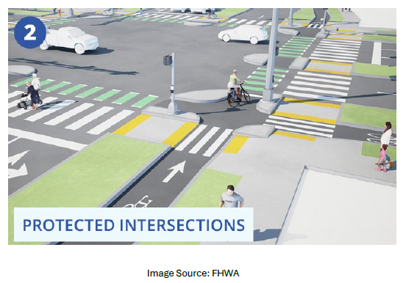
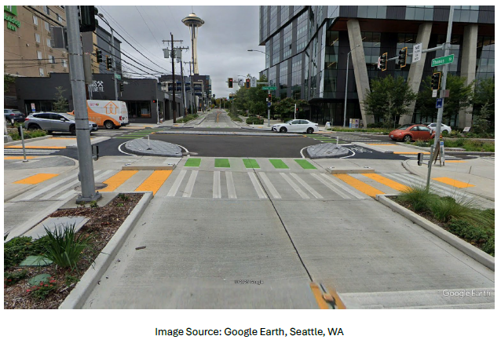
Protected Intersections
Notes:
MIKE
Protected intersections use a setback or offset design to minimize conflict points and improve visibility between drivers, pedestrians, and/or bicyclists. Features of protected intersections include pedestrian refuge islands, bicycle queuing areas, corner islands, and clear crossing markings. The purpose of these features is to safeguard all road users and improve predictability. When building a protected intersection, it is essential to consider multiple factors — including accessibility requirements — to create effective solutions adapted to the surrounding roadway context.
At protected intersections, bicyclists making right turns encounter no conflicts with vehicles and left turns can be executed in two stages, allowing bicyclists to avoid merging across lanes of traffic.

Slide 27
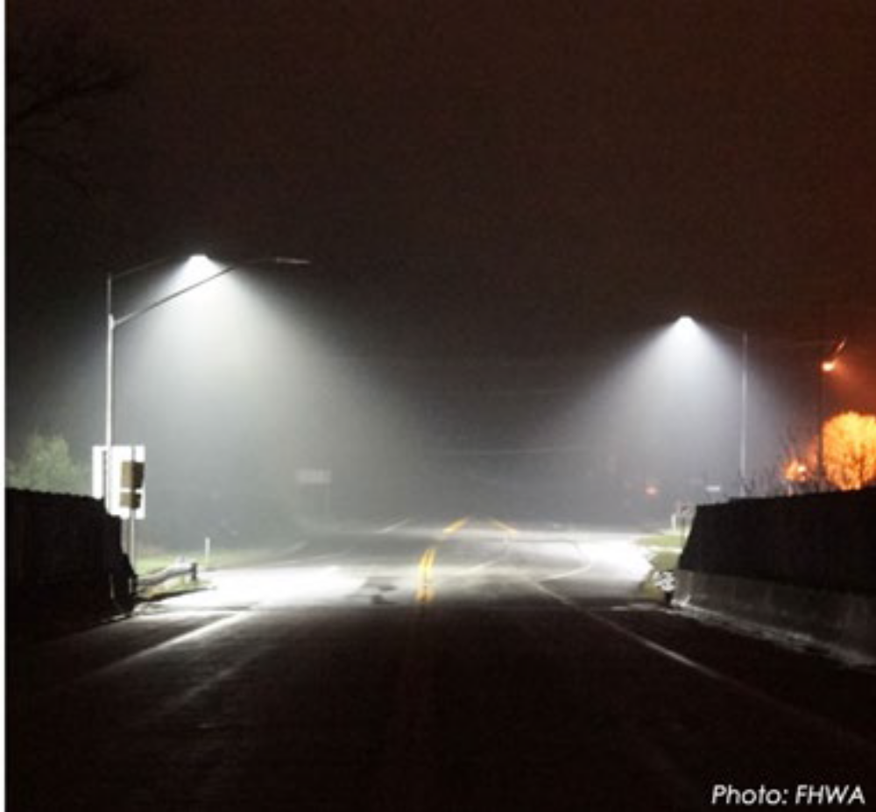
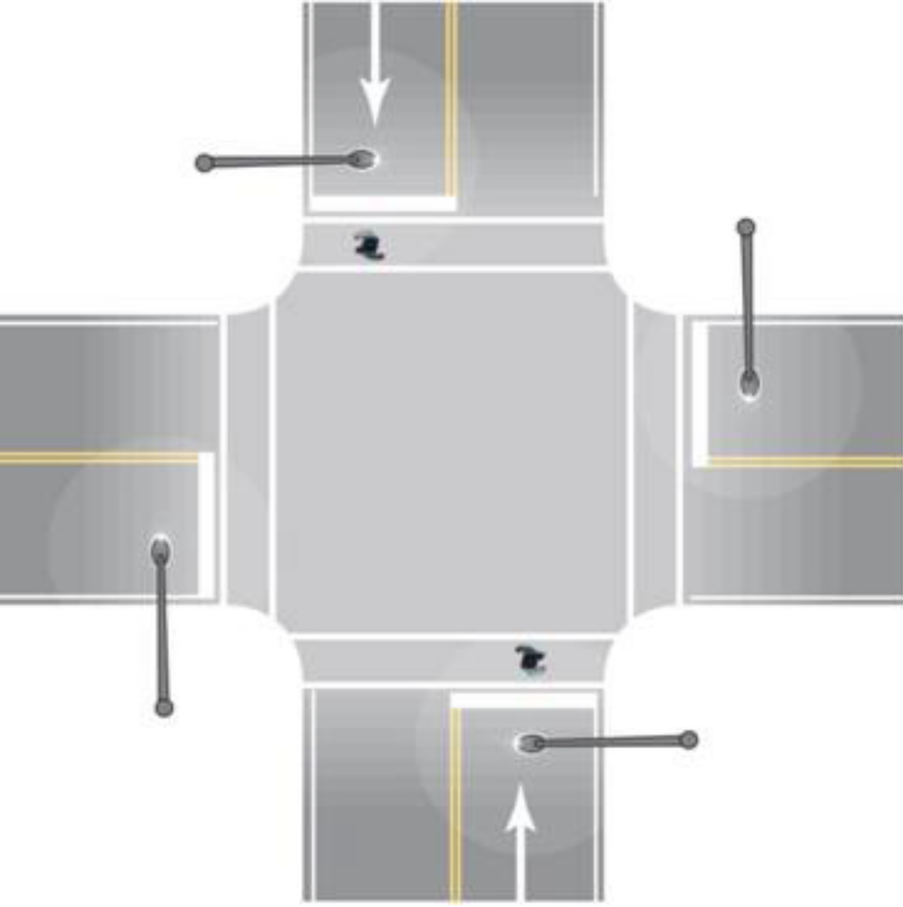
Lighting
Image Source: FHWA
Notes:
JASON
Lighting can be installed continuously along segments of roadway, at intersections, and at spot locations to improve visibility of the roadway, other vehicles, and pedestrian crossings. Limited visibility contributes to nighttime collisions. KYTC’s Complete Streets Manual includes references to roadway lighting and multimodal lighting.
Despite 25% of travel taking place at night, approximately half of all traffic fatalities occur during this period. Lighting can reduce nighttime injury crashes on rural and urban highways up to 28%, nighttime injury pedestrian crashes at intersections up to 42%, and nighttime crashes at rural and urban intersections between 33% – 38% (FHWA, 2023).

Slide 28
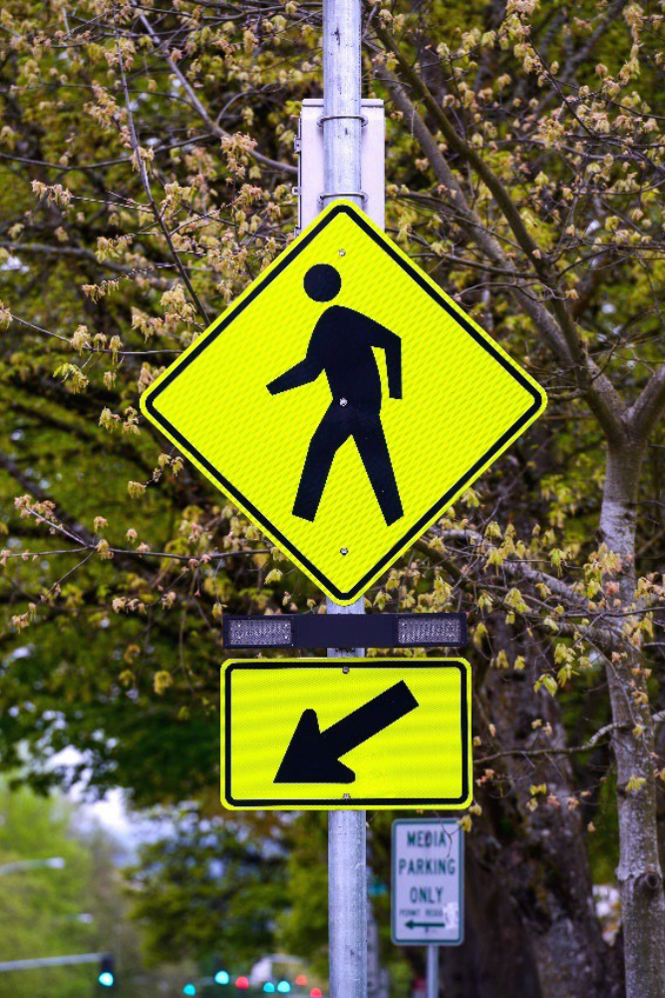
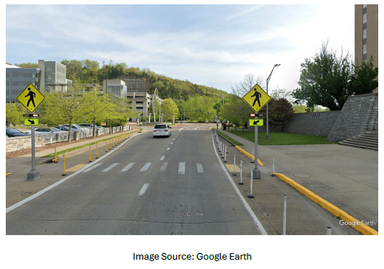
Rectangular Rapid Flashing Beacon (RRFB)
Notes:
JASON
Rectangular Rapid Flashing Beacons (RRFBs) are used to provide emphasis to warning signs at marked crosswalks across uncontrolled approaches. RRFBs consist of two rectangular-shaped yellow indications, each with a light-emitting diode (LED)-array-based light source. RRFBs display alternating high frequency flashes when activated. They can be activated with pedestrian pushbuttons (active detection) or by video, radar, etc. (passive detection) and remain unlit when not activated.
When used at appropriate locations, RRFBs can reduce pedestrian crashes up to 47% and increase motorist yield rates up to 98% (CMF ID 9024).

Slide 29
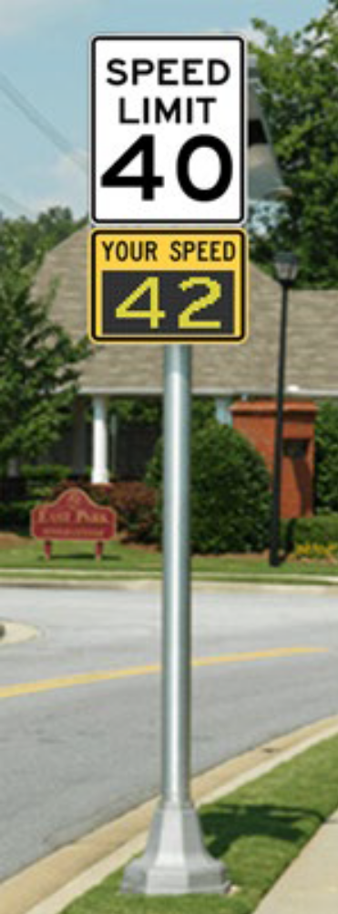
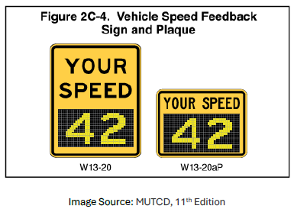
Speed Feedback Signs
Notes:
JASON
Dynamic speed feedback signs contain devices that measure the speed of an approaching vehicle and displays the speed to the vehicle operator. They are used to provide warning to drivers of their speed in relation to either a speed limit (R2-1) sign or a horizontal alignment warning sign assembly with an advisory speed. Sign installations can be permanent or temporary. They are often used in transitions zones that link high-speed to low-speed contexts or on approaches to curves on high-speed roadways to help prevent roadway departure crashes. Installations on two-lane rural horizontal curves are associated with CMFs of 0.93 – 0.95 (Hallmark et al., 2015).

Slide 30
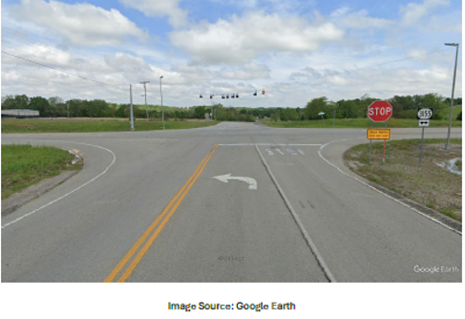
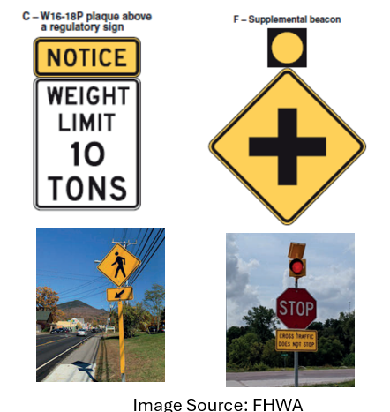
Enhanced Signing
Notes:
JASON
Improving the quality and conspicuity of signs provides earlier warnings to motorists as they approach potentially hazardous locations (e.g., intersections, horizontal curves).
Includes such treatments as installing larger signs, dual-mounting signs, and improving sign conspicuity such as beacons, RRFBs, NOTICE plaques, and retroreflective strips to sign supports.
It can also include adding or replacing delineation, object markers, and appropriate horizontal curve warning sign treatments.

Slide 31

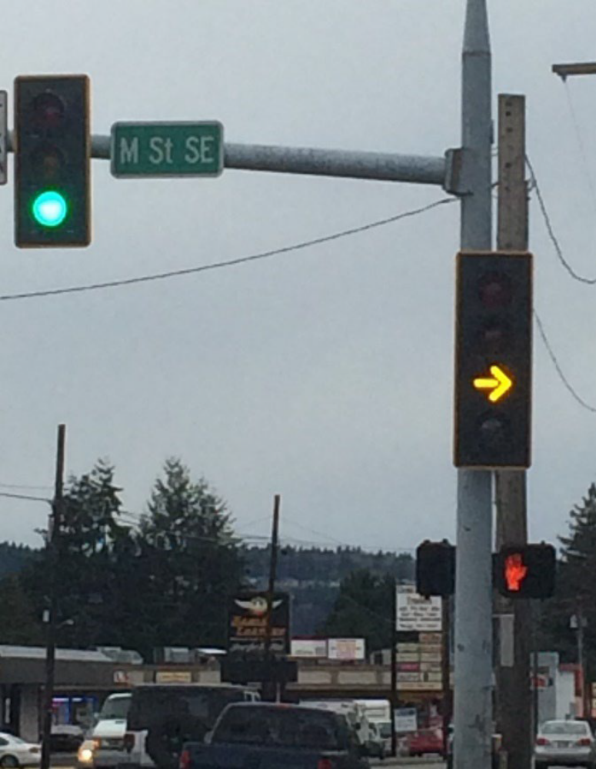
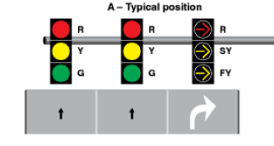
Flashing Yellow Arrows for Right Turns
Notes:
JASON
Adding flashing right turn arrows provides a strong visual reminder that turning vehicles must yield to pedestrians and bicycles. It is very important to note flashing right turn arrows can only be used if there is an exclusive right turn lane and cannot be used for a shared through/right turn lane.

Slide 32
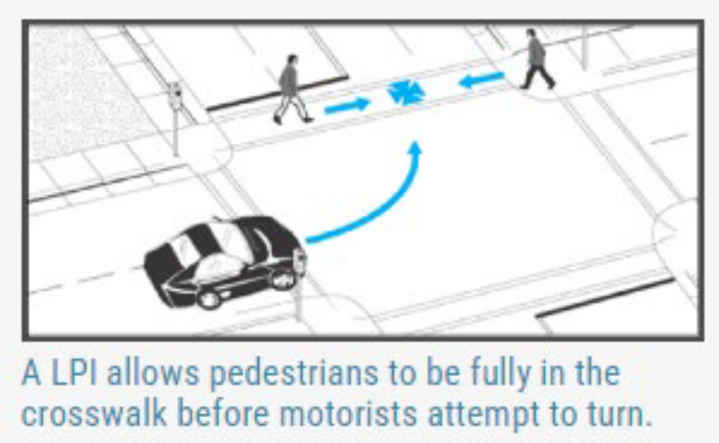
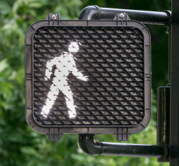
Leading Pedestrian Intervals (LPI)
Image Source: PEDSAFE
Notes:
JASON
A leading pedestrian interval (LPI) provides an advance WALKING PERSON (symbolizing WALK) indication to be displayed for the crosswalk while red indications continue to be displayed to parallel through and/or turning traffic. An LPI lets pedestrians enter an intersection crosswalk 3 – 7 seconds before turning vehicles receive a green indication, allowing pedestrians to better establish their presence in the crosswalk before conflicting vehicles can turn right or left. FHWA reports use of LPIs result in a 13% reduction in pedestrian-vehicle crashes at intersections.

Slide 33
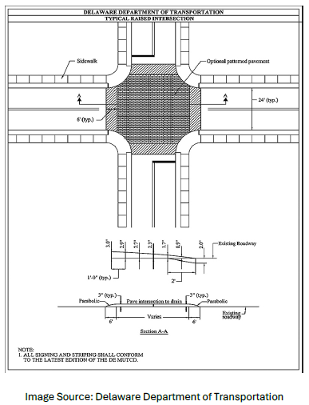
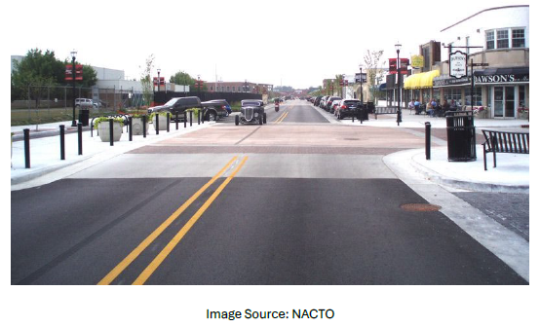
Raised Intersections
Notes:
MIKE
A raised intersection functions like a speed table but extends across the full width of the intersection. Ramps are installed on each approach, and the intersection elevation is flush with the sidewalk’s elevation. Raised intersections encourage motorists to slow down and yield to pedestrians.

Slide 34

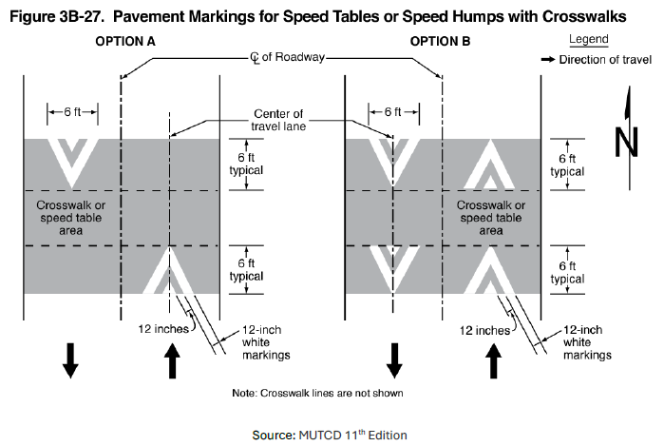
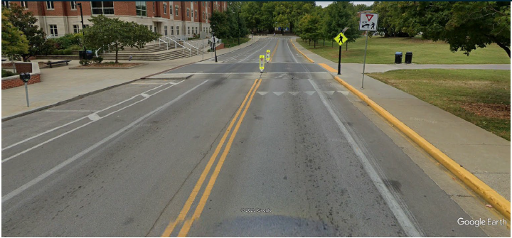
Speed Tables and Raised Crosswalks
Notes:
MIKE
A speed table is a raised area installed across the roadway to limit vehicle speeds. It extends across the roadway and has a flat top sufficiently long (typically, 10 feet) to accommodate the entire wheelbase of most passenger vehicles. Compared to speed humps, their extended longitudinal depth in the direction of travel enables faster vehicle operating speeds while preserving motorist comfort and safety. Raised crosswalks may be placed on top of speed tables.
Three field studies of 27 speed tables measured crash reductions of 36% – 64%. Six field studies of 98 speed tables measured reductions in 85th percentile speeds of 4 mph – 11 mph (FHWA, Engineering Speed Management Countermeasures: A Desktop Reference of Potential Effectiveness in Reducing Crashes, July 2014). Raised crosswalks can reduce pedestrian crashes by up to 45% (FHWA, Countermeasure Tech Sheet, June 2018).

Slide 35
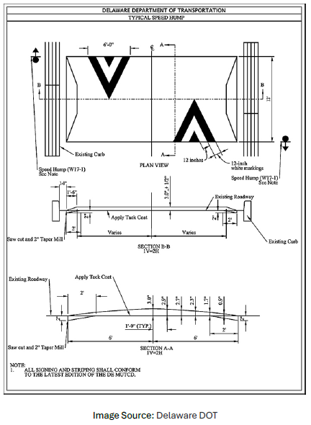
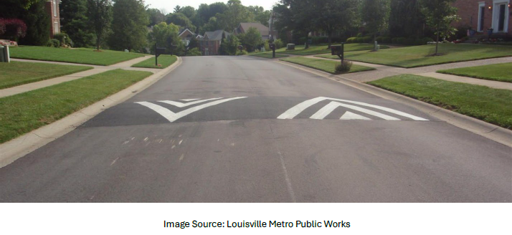
Speed Hump
Notes:
MIKE
A speed hump is an elongated mound in the roadway pavement surface that extends across the travel way perpendicular to the traffic flow. A speed hump discourages speeding by producing discomfort if a motorist exceeds the design speed while driving over it.
Five field studies of 51 speed humps measured crash reductions between 33% and 48%. Seven field studies of 199 speed humps measured speed reductions between 6 mph and 13 mph for 85th percentile speeds (FHWA, Engineering Speed Management Countermeasures: A Desktop Reference of Potential Effectiveness in Reducing Crashes, July 2014).

Slide 36

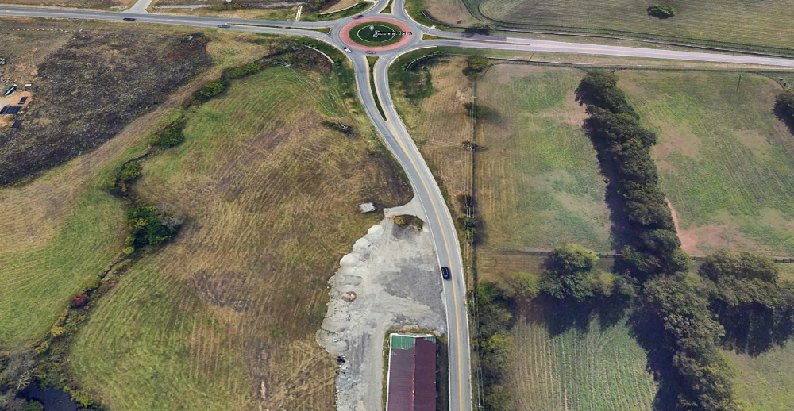
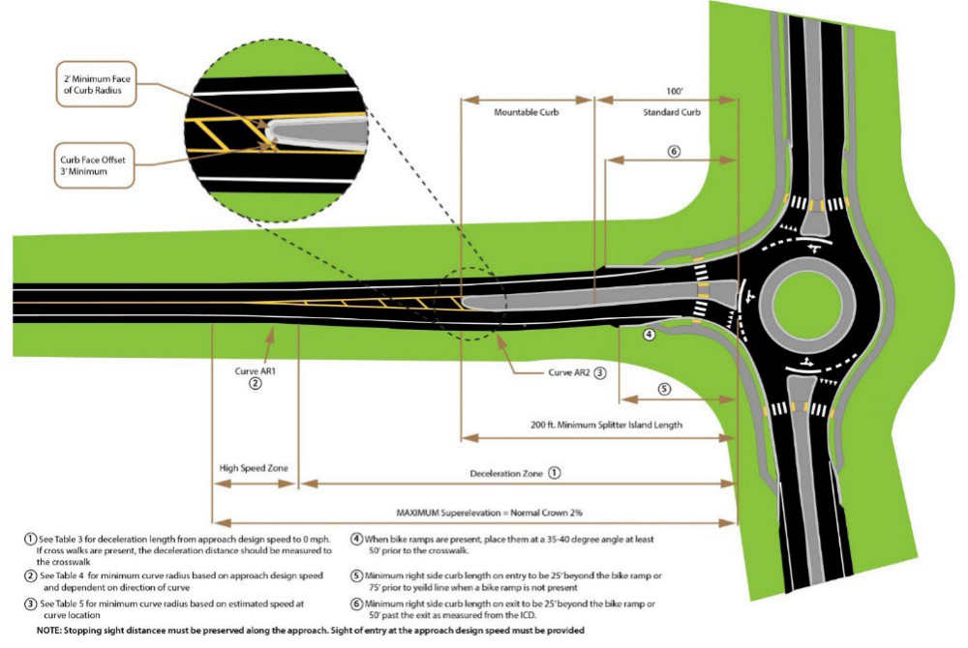
Successively Smaller Curves
Notes:
MIKE
A series of progressively sharper curves creates a self-enforcing roadway that encourages motorists to reduce speeds. These commonly take the form of reverse curves separated by a tangent, where a broad-radius curve is followed by a moderate-radius curve. Actual speeds associated with these radii vary by roadway approach speed and deceleration needs.

Slide 37
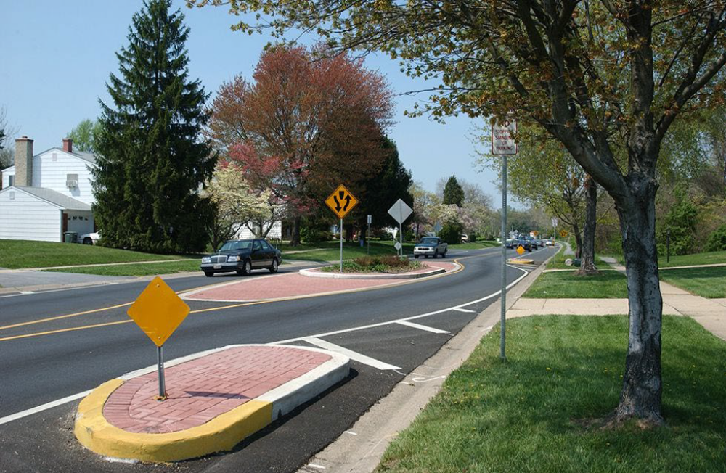
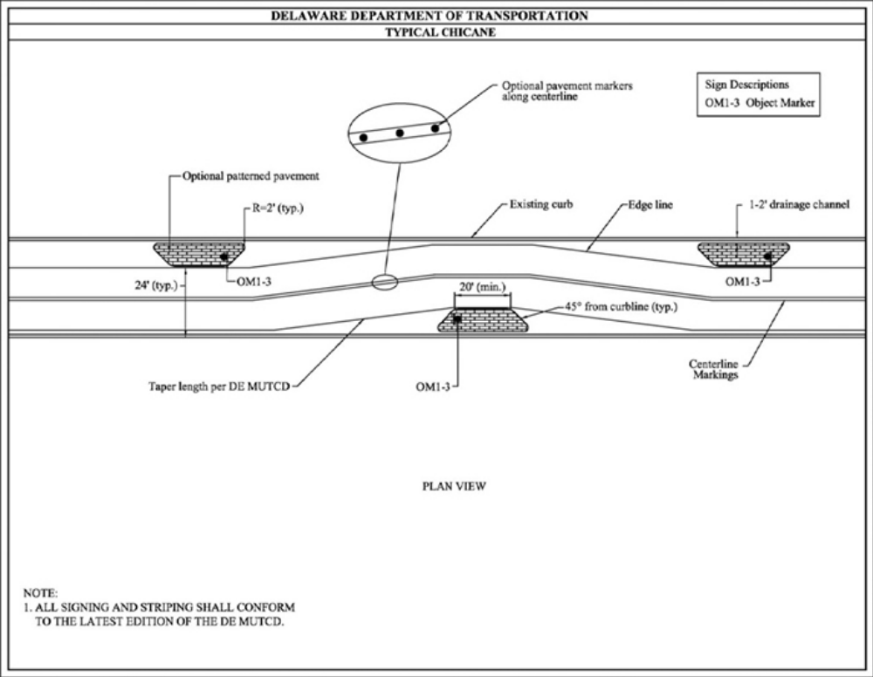
Lateral Shifts and Chicanes
Notes:
MIKE
A lateral shift realigns a straight street by shifting traffic in one direction (i.e., to the left or right). Chicanes are a series of alternating lateral shifts that create multiple changes in direction along a roadway segment. Both Lateral Shifts and Chicanes use features such as pavement markings, planting strips, on-street parking, and other features create a sequence of horizontal curves intended to slow vehicle speeds, improve driver attentiveness and reduce crash risk. Curves or shifts can be gentle for modest speed reduction, or more restrictive for greater speed management. Shifts in travel-ways can be created by moving parking from one side of the street to the other (if there is only space for one side of parking), or by building landscaped or hardscaped islands.

Slide 38
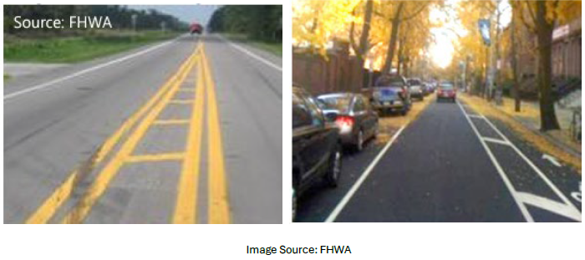
Roadway Narrowing with Pavement Markings
Notes:
JASON
Roadway narrowing is often done as part of resurfacing or roadway improvement projects. It may include repurposing additional paved space with markings or physically removing unused paved areas. Narrower lanes encourage reduced operating speeds, and excess width may be used to accommodate complementary safety strategies.

Slide 39
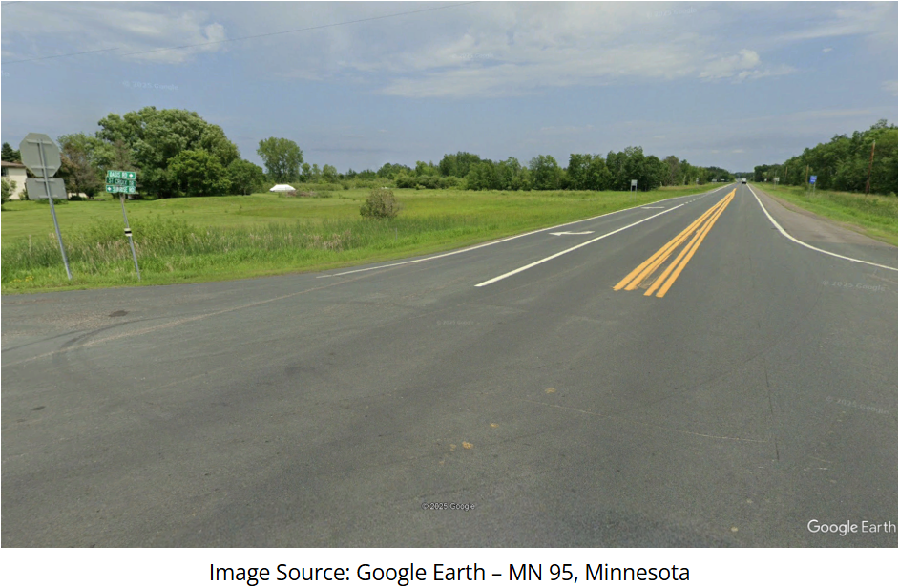

Intersection Buffers
Notes:
JASON
Intersection buffer treatments can be applied at rural, high-speed intersections with side-street stop control. They narrow the mainline approach intersections by adding a striped buffer area that includes centerline rumble strips. This narrowing is intended to encourage drivers to reduce speed as they approach the intersection. The striped buffer area also enhances separation between opposing traffic and increases the visibility of the intersection. Following installations in Minnesota, fatal and injury collisions decreased by 22%.

Slide 40


Speed Reduction Markings
Notes:
JASON
Speed Reduction Markings, or optical speed bars (OSBs), are white transverse pavement markings placed on both sides of a lane perpendicular to the centerline, edge line, or lane line with the goal of reducing vehicle operating speeds. The distance between successive bars is reduced progressively to give motorists the impression that their speed is increasing.

Slide 41


Transverse Pavement Rumbles
Notes:
JASON
Transverse rumble strips are placed in travel lanes perpendicular to the direction of travel. The noise tires make when they contact the rumbles alert motorists to slow down. They are typically located on approaches to intersections, horizontal curves, work zones, and the ends of freeways.

Slide 42


Using Traffic Signal Timing to Meet Target Speeds
Notes:
JASON
Conventional traffic calming techniques are not usually applicable for controlling speeds on urban and suburban arterials. Due to the presence of vulnerable road users on these facilities, speed management is important, but enforcement is difficult to accomplish using traditional methods. On corridors with traffic signal systems, case studies show that it is possible to substantially reduce speeding opportunities with little or no impacts to vehicle delays by reducing cycle length and progression speed and dividing the arterial into smaller “coordination zones” (Furth et.al., 2018).

Slide 43

Rest in Red
Notes:
JASON
Under ‘Rest-In-Red’ (RIR) traffic signal operation, a traffic signal remains red in all directions until a green phase is triggered by a motorist or pedestrian. It is an effective, low-cost speed management tool under certain circumstances. Long-range detection enables anticipation of vehicles and changes the signal to green before a vehicle needs to significantly decrease its speed. It encourages safer speeds through intersections during late night and early morning hours.

Slide 44


Sequential Dynamic Chevron Warning System
Notes:
JASON
A sequential dynamic curve warning system (SDCWS) consists of a series of solar-powered LED chevron signs installed along a curve. Signs flash in sequence when a radar or another detection device detects approaching vehicles, alerting drivers to reduce their speeds as they navigate the curve. They can replace existing chevrons and are beneficial in low-visibility conditions.

Slide 45



Friction Surface Treatments
Notes:
MIKE
High friction surface treatments (HFSTs) consist of high-quality aggregate bonded to pavement using a polymer binder. They restore and/or maintain pavement friction in areas with high crash rates or which are at risk for high crash rates. HFST applications can reduce crashes, injuries, and fatalities associated with friction demand issues, such as:
•Reduced pavement friction during wet conditions, and/or
•High friction demand due to vehicle speed and/or roadway geometrics.
HFSTs can lower wet weather crashes up to 83 percent and total crashes up to 57 percent. Other friction treatments may also be considered.

Slide 46



Centerline Buffers
Notes:
MIKE
Centerline buffer areas establish additional space between centerline markings, increasing separation between opposing traffic on undivided roadways. Rumble stripes along the buffer edges alert drivers, while the buffer itself provides space for an errant vehicle to recover, helping reduce head-on crashes.

Slide 47

Median Barriers on Undivided Highways
Notes:
MIKE
Median barriers separate opposing traffic and reduce head-on crashes. In the U.S., median barriers on undivided roadways are uncommon; however, other countries (e.g., Sweden) have used them with positive results. Examples include cable barrier and double-faced guardrail. Some State DOTs in the U.S. are piloting cable barrier in narrow medians.

Slide 48


Cable Median Barrier
Notes:
MIKE
Cable barriers are flexible barriers made from steel cables mounted on weak steel posts that mitigate the severity of roadway departure collisions. They capture or redirect errant vehicles and reduce the amount of kinetic energy absorbed by vehicles and their occupants.

Slide 49



Increase Use of Roadside Barriers
and End Terminals
Notes:
MIKE
When it is not feasible to remove or relocate a roadside obstacle, it may be shielded by a longitudinal traffic barrier or crash cushion. A roadside barrier redirects or contains errant vehicles, improving safety by preventing more severe outcomes. Barrier examples include guardrail, cable rail, and concrete barriers.
Barrier end treatments (e.g., anchorages, terminals, crash cushions) are essential components that safely absorb or redirect vehicle impacts at the ends of barriers. Proper end treatment selection and installation are critical, as untreated barrier ends can pose severe hazards.
The Crash Modification Factor (CMF) Clearinghouse contains several CMFs for adding new guardrail along embankments. Guardrail installations can reduce run-off-road injury crashes by up to 47% and fatal crashes up to 44%.

Slide 50


Superelevation Improvement
Notes:
MIKE
Superelevation promotes motorist comfort as they accelerate a vehicle through a curve. It works with friction between the tires and pavement to assist vehicles in maneuvering through curves. Superelevation may be inadequate due to design errors, lost over time due to settling, pavement overlays, or mistakes made during the original construction. Curves with inadequate superelevation may increase crash risk. Safety can be enhanced when the superelevation is improved or restored along curves where the actual superelevation is below optimal levels.

Slide 51


Curve Widening
Image Source: AASHTO Highway Safety Manual Figure 10-8
Notes:
MIKE
Roadway departure crashes frequently occur on horizontal curves, which are significantly overrepresented in crash statistics. The presence of shoulders—whether paved or unpaved—plays a major role in a driver’s ability to recover control after leaving the traveled way. While it may not always be feasible to widen highways for continuous shoulders, adding shoulder width at critical locations—such as curves, where roadway departures are more likely—can be beneficial.

Slide 52


Address Visual Traps with Pavement Markings
Notes:
JASON
Longitudinal pavement markings (e.g., edge lines, lane lines and center lines) typically discontinue in areas such as intersections and large, commercial entrances. Offset, skewed, complex, or multi-leg intersections, on curved roadways, may create “visual traps” and cause driver confusion. Multiple or offset left-turn lanes may also benefit from dotted lane line extensions to guide drivers as they complete their turn. Dotted lane line extensions can be used to better delineate the intended vehicle path through intersections.

Slide 53

Supplemental In-Lane Pavement Markings
Image Source: Frank Julian
Notes:
JASON
Regulatory, warning, or guidance messages provided by signs may also be placed in the lane using elongated pavement markings. Messages such as the posted speed limit or Stop Ahead or Curve Ahead markings may supplement signs by providing the same information in the driver’s direct line of sight.

Slide 54
Back-In Angle Parking
Notes:
JASON
Back-in angle, or reverse angle, parking requires motorists to reverse their vehicle into an angled parking space instead of pulling forward into it. With the front of their vehicle facing the street, a motorist has improved sight distance when leaving a parking space. This type of parking also allows for rear loading at curbs instead of along travel lanes. Additionally, passengers are channeled toward the curb instead of the street.

Slide 55

Convert Low Volume Intersections to
All-Way Stop Control
Notes:
MIKE
All-way stop control (AWSC) is implemented by placing stop signs on each leg of an intersection. It is a quick, cost-effective method for alleviating crash problems at intersections with high-severity impact crashes. North Carolina DOT converted 50 intersections from two-way stop control (TWSC) to AWSC and saw a 77% reduction in fatal and injury crashes at the treated intersections.

Slide 56


Positive Offset Turn Lanes
Notes:
MIKE
The typical geometry and operation of signalized intersections can present several challenges. Sight distance is important for drivers to identify acceptable gaps in opposing traffic. Opposing left-turn lanes are typically aligned directly across from one another and immediately adjacent to the through lanes. Thus, a left-turning vehicle in the left-turn lane can obstruct the view of oncoming vehicles, particularly those in the opposite left-turn lane. For right-turn lanes, this typically involves right-turning vehicles from the major road and vehicles entering the intersection from the minor road. To improve sight distance and safety at intersections, the use of offset turn lanes is recommended.

Slide 57


Two Way Left Turn Lane Restrictions
Notes:
MIKE
Two-way left-turn lanes (TWLTLs) enhance safety and traffic flow at locations with moderate traffic volumes and moderate to high access point densities. They are typically installed when access densities increase to the point where providing exclusive left-turn lanes with sufficient deceleration space and storage length is impractical without establishing conflicts with adjacent access points. On roadways that already have a TWLTL and few or no access points, a non-traversable median in the center lane can discourage motorists from passing in the turn lane.

Slide 58

Roadway Reconfiguration
Notes:
MIKE
Resurfacing projects open the door to reconsidering how to best use the available roadway width. In many cases, existing striping patterns were established long ago and there may have been significant changes over the years that would lead to updated choices involving such things as the number of through lanes, the need for turn lanes, pedestrian refuge, bicycle facilities, parking, and others.
Note that this treatment is called “roadway reconfiguration” and not a “road diet” so that it more appropriately describes the project in a positive light. Nobody likes “diets”!!!

Slide 59


Slope Flattening
Notes:
MIKE
Slope flattening reduces the steepness of the roadside and median slopes so that errant motorists are more likely to keep their vehicles stable, regain control, and avoid obstacles. Slopes of 4H:1V or flatter are recoverable (i.e., motorists can retain control of a vehicle by slowing or stopping). Slopes between 3H:1V and 4H:1V are generally considered traversable, but non-recoverable (i.e., the errant vehicle will continue to the bottom of the slope).
Foreslopes, or fill slopes, are parallel to the flow of traffic and are negative slopes extending from the roadway shoulder down to the ditch or toe. The backslope is a positive slope that extends upward from the base of the foreslope or toe of the ditch. Transverse slopes are not parallel to the roadway and are usually created by median crossovers, berms, driveways, or intersecting roadways.

Slide 60
THE SAFE SYSTEM APPROACH
WHY? HOW? WHAT?
THANK YOU!

